Slide 1
The Safe Start AI Toolkit: Practical Uses & Guardrails that Stick
Eric Molho
bonpartners.org

Slide 2

Who Am I and Why Am I Here?
Strategic planning/Marketing planning
Not a programmer, not an early adopter, not a techie
Curious and lifelong learner
ERIC MOLHO
FOUNDER & PRINCIPAL
BON PARTNERS
BONPARTNERS.ORG
Notes:
All three of us

Slide 3

Your mission
Create a culture of AI usage in your organization that:
Helps everyone become more efficient and effective
Creates a culture of transparency and accuracy around AI usage
Honors your organization’s values, mission and responsibilities

Slide 4
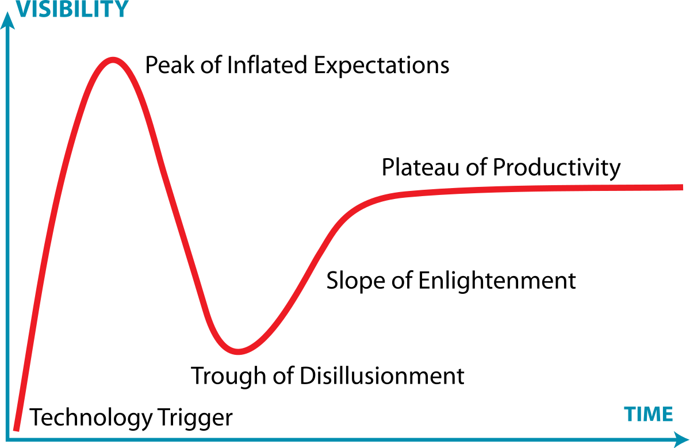
Generative Artificial Intelligence (AI)
Generative: creates new things
Predictive: not programmed
November 30, 2022: ChatGPT Released to the public
Notes:
Eric

Slide 5
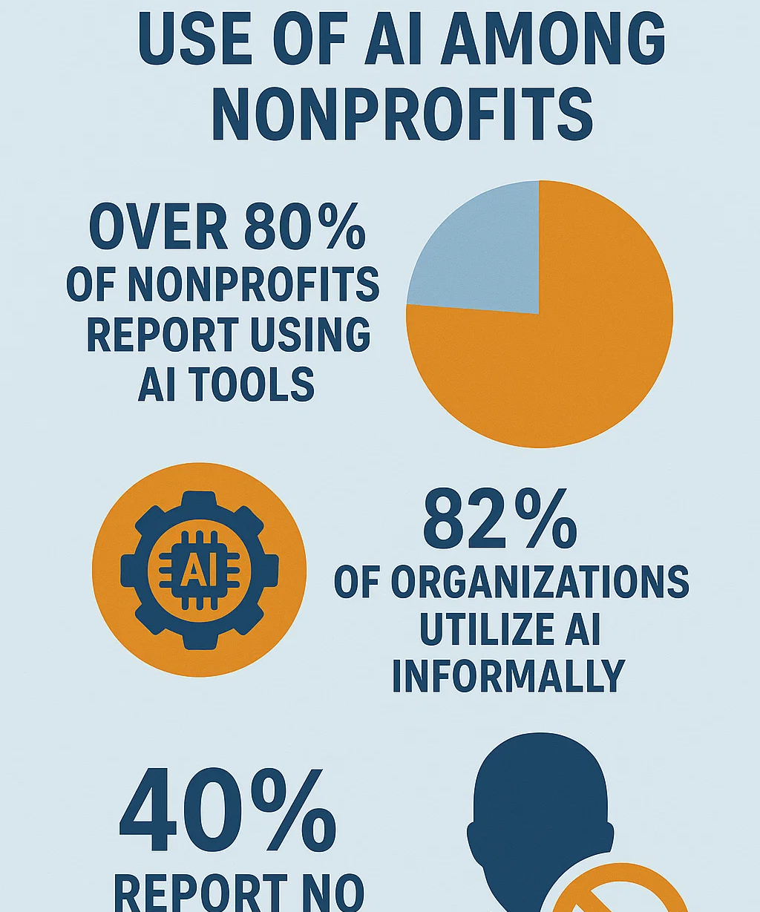
What’s Going On?
📊 AI Adoption in Nonprofits
Widespread Usage: Over 80% of nonprofits report using AI tools in some capacity, primarily for tasks like content creation, grant writing, and internal productivity enhancements. Non Profit News | Nonprofit Quarterly
Informal Implementation: A substantial 82% of organizations utilize AI informally, often without structured integration into team processes. Bloomerang
Limited Staff Training: Approximately 40% of nonprofits indicate that no one in their organization has received education or training in AI. Nonprofit Tech for Good

Slide 6
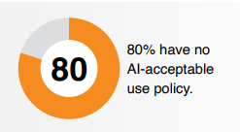
AND . . .
⚠️ We Lack AI Policies
Policy Deficiency: A significant 80% of nonprofits do not have an AI policy in place, leaving them vulnerable to issues related to data privacy, security, and ethical considerations. TechSoup 2025 Survey
Foundations Lagging: Among philanthropic foundations, only 30% have established an AI policy, and a mere 4% report enterprise-wide AI adoption. Technology Association of Grantmakers
Unpreparedness: A staggering 92% of nonprofits feel unprepared for AI integration, citing inadequate infrastructure and a lack of clear policies. Non Profit News | Nonprofit Quarterly+1Bloomerang+1

Slide 7

So what?
Your client, organizational and donor data may be used improperly.
Your team isn’t sure what is permitted/isn’t permitted.

Slide 8
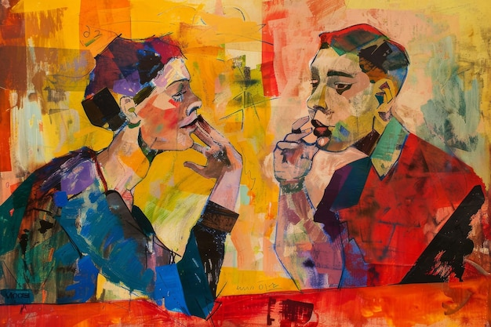
Turn and Chat
How is AI being used in your organization today?
Do you have an acceptable use policy/clear guidelines for all staff?
What’s the “vibe” around AI in your work?

Slide 9

One Framework for thinking about AI:
Your Eager Intern
Knows some stuff . . .
but not everything
Work products are good. . .
but not ready for prime time
Is eager to help . . .
but makes mistakes
Can be assigned basic/repetitive tasks. . .
but the work needs to be checked

Slide 10
Data Analysis with AI
Qualitative Examples:
Survey responses
Objections/reactions
Process improvements
Analyze content
Quantitative Examples:
Donor analysis and predictive fundraising
Program impact measurement
Resource allocation optimization
Marketing and campaign evaluation and targeting

Slide 11
Before we analyze ANY data
You should think of everything you put into a free, online AI tool as (essentially) public.
Would you publish this on your website?
What is our organization’s POLICY (stay tuned!)
How will we ensure data security and privacy

Slide 12
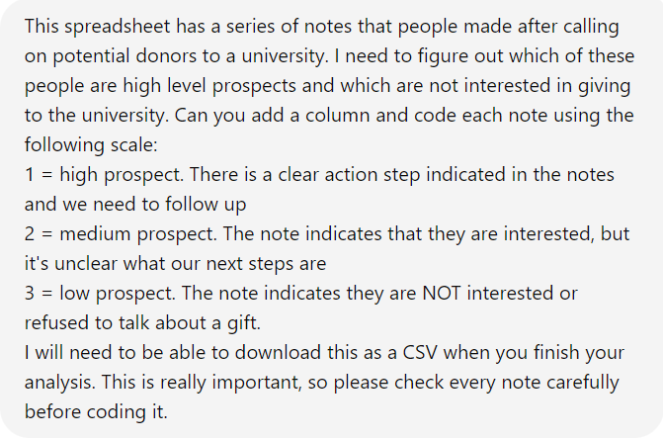
The Prompt
Provide the background/context
Provide the goal
Tell the intent & purpose
Give instructions and guidelines
Request the final format

Slide 13
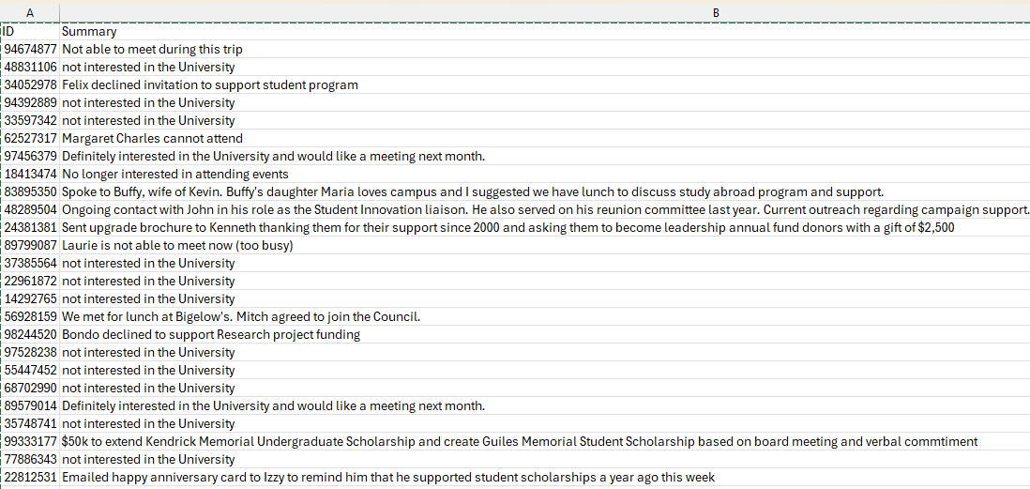
The Scenario
Use Case: Coding
We have downloaded call notes from our system.
Different users, staff and volunteers have used different approaches to these notes.
Can we get a jump on sorting all this data?
All data shown in this presentation is fictitious! No databases were harmed in the creation of these slides.

Slide 14
The Result
High:
Definitely interested in the University and would like a meeting next month.
Spoke to Buffy, wife of Kevin. Buffy's daughter Maria loves campus and I suggested we have lunch to discuss study abroad program and support.
Sent upgrade brochure to Kenneth thanking them for their support since 2000 and asking them to become leadership annual fund donors with a gift of $2,500
We met for lunch at Bigelow's. Mitch agreed to join the Council.
$50k to extend Kendrick Memorial Undergraduate Scholarship and create Guiles Memorial Student Scholarship based on board meeting and verbal commitment
Sent Dominic an email asking for an update if he would like to move ahead with a gift to establish the full Graduate Student Honors Program based on how pleased he was with the intern program
Elisa agreed to join the Volunteer Council.
Met with Sam to discuss interest in the Council. Adam would like to participate.
Agreed to visit campus again to meet to discuss ideas for support
Medium
Not able to meet during this trip
Sent Mary an introductory postcard thanking her for continued support and offering to grab coffee with her soon to learn more about her interests in support of the university.
Demi asked for report and expressed concern of event date
Not able to meet during this trip
Emailed about continued funding or guidance regarding facilities project based on lab meeting
Marsha cannot attend Board meeting in March
Low:
not interested in the University
not interested in the University
Miriam declined visit and is no longer interested in the Center.
not interested in the University
Ken's no longer wishes to support the university. Unhappy with recently handling of gift recognition ceremony cancellation.
Beverly responded to my email to let me know she and Bob regrettably did not enjoy the University Science Fellows meeting
Still needs to be reviewed!
Did it get 80% of the work done for me?

Slide 15
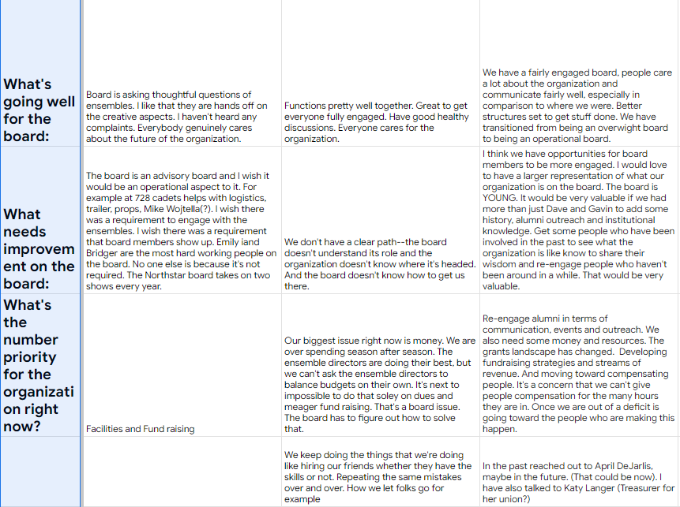
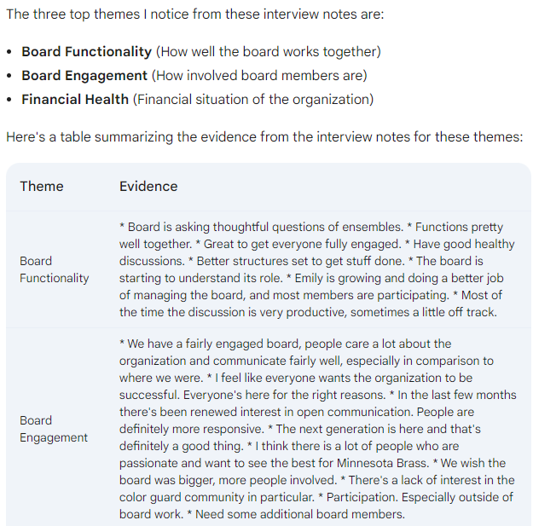
Use Case: Summaries

Slide 16
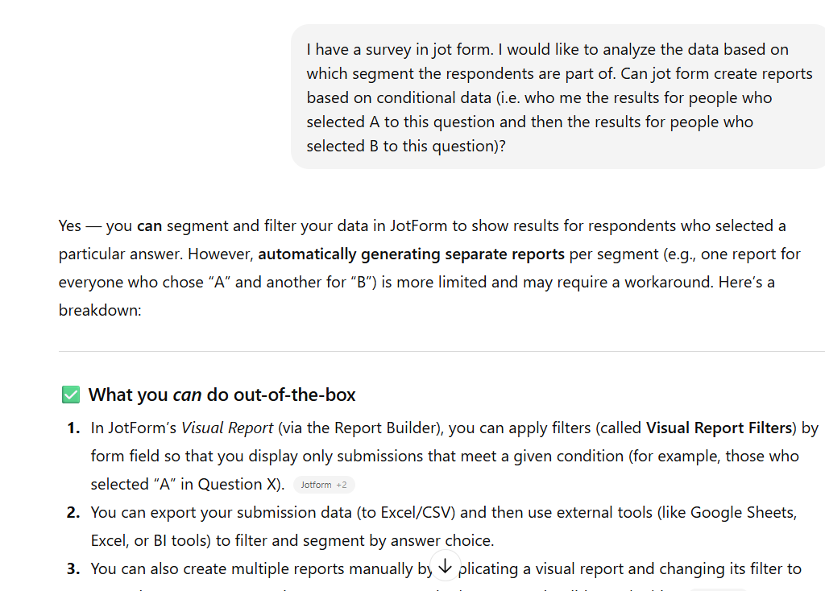
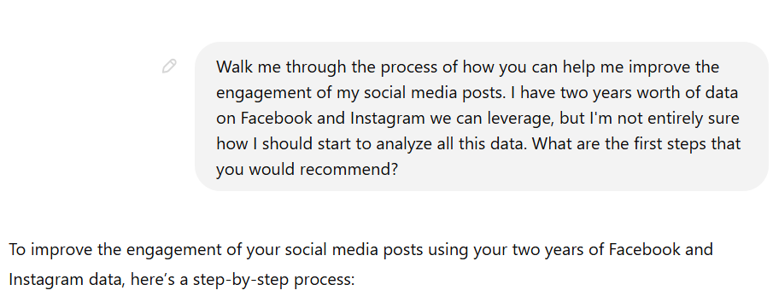
Use Case: Improve your own skills

Slide 17
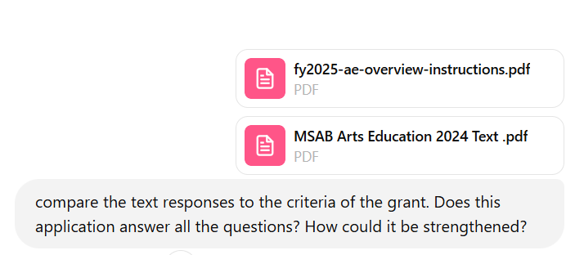
Use Case: Meeting Grant Criteria
Compare responses to RFP/instructions
“Did I address every aspect of this application?”
Strengthen response
“How could I make this stronger?”
Notes:
Eric

Slide 18
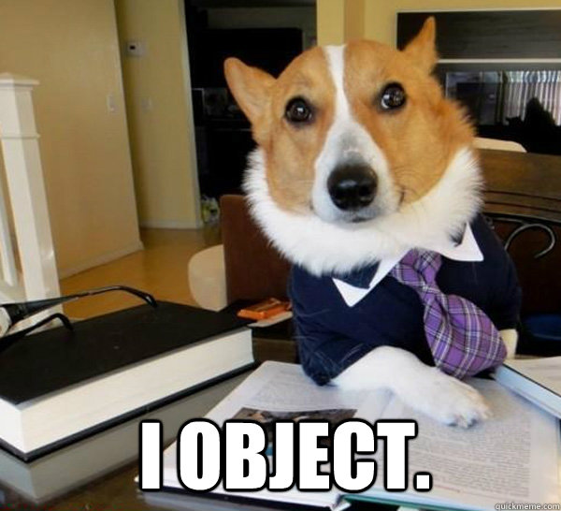
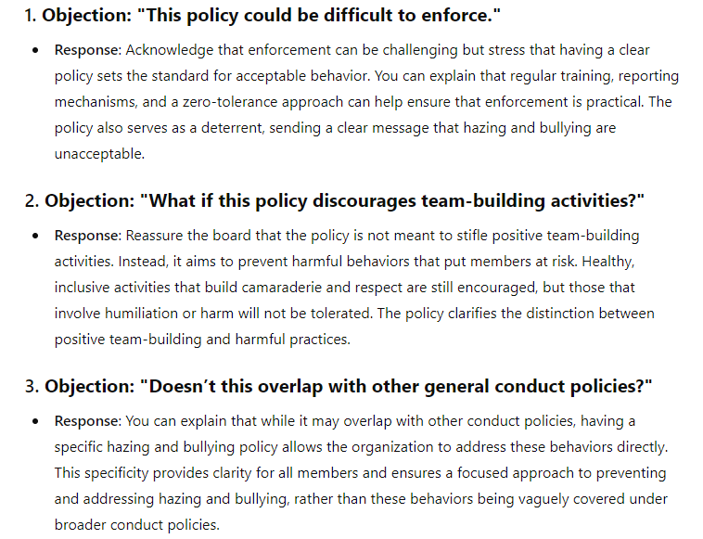
Use Case: Objections

Slide 19
Preparing Your Data for AI
Protect
Privacy: Essential for ethical and legal compliance
Remove
Personally Identifiable Information
Names, addresses, contact details.
Instead use ID numbers (key) and lookup offline
Generalize
Ages, giving amounts, relationships to your organization.
Use ranges, rating (hi/medium/lo)
Mask
Using codes or pseudonyms
(A-level, B-level, etc.)

Slide 20

Exercise: How would we anonymize this data?
ID Number
Lifetime Giving total
Email
BusPhone
Grad Year
Marital Status
SpouseID
JobTitle
Varsity Ath
StudGovt
OtherStudActs
Greek
Prefix

Slide 21
Exercise: How would we anonymize this data?
Maybe okay. Can’t be SSN or birthdate or some other private information
Maybe code into ranges?
Do not use in AI
Do not use in AI
Maybe mask? Maybe group into decades?
Maybe mask or code using numbers?
Maybe okay but will our analysis take us here?
Maybe okay or consider coding
Change the field title and code with key or Y/N
Change the field title and code with key or Y/N
Change the field title and code with key or Y/N
Change the field title and code with key or Y/N
Maybe okay but consider coding
ID Number
Lifetime Giving total
Email
BusPhone
Grad Year
Marital Status
SpouseID
JobTitle
Varsity Ath
StudGovt
OtherStudActs
Greek
Prefix

Slide 22
Exercise: How would we anonymize this data?
890257
2500
luis@aol.com
507-567-8912
1993
Married
875641
Vice President
Football
blank
Environmental Club
Alpha Beta
Mr.
890257
2.5 (gifts in 000s)
-
-
409356 or G (A = 40s, B = 50s, C = 60s etc.)
1 (1 = married, 2 = single, 3 = unknown)
875641
A (A = senior level, B = manager level)
Y (yes or no)
N (yes or no)
22 (key with each club identified
2 (key with each Greek org. identified)
4 (1 = Mrs., 2 = Ms., 3 = Dr., 4 = Mr. etc.)
ID Number
Lifetime Giving total
Email
BusPhone
Grad Year
Marital Status
SpouseID
JobTitle
Varsity Ath
StudGovt
OtherStudActs
Greek
Prefix

Slide 23
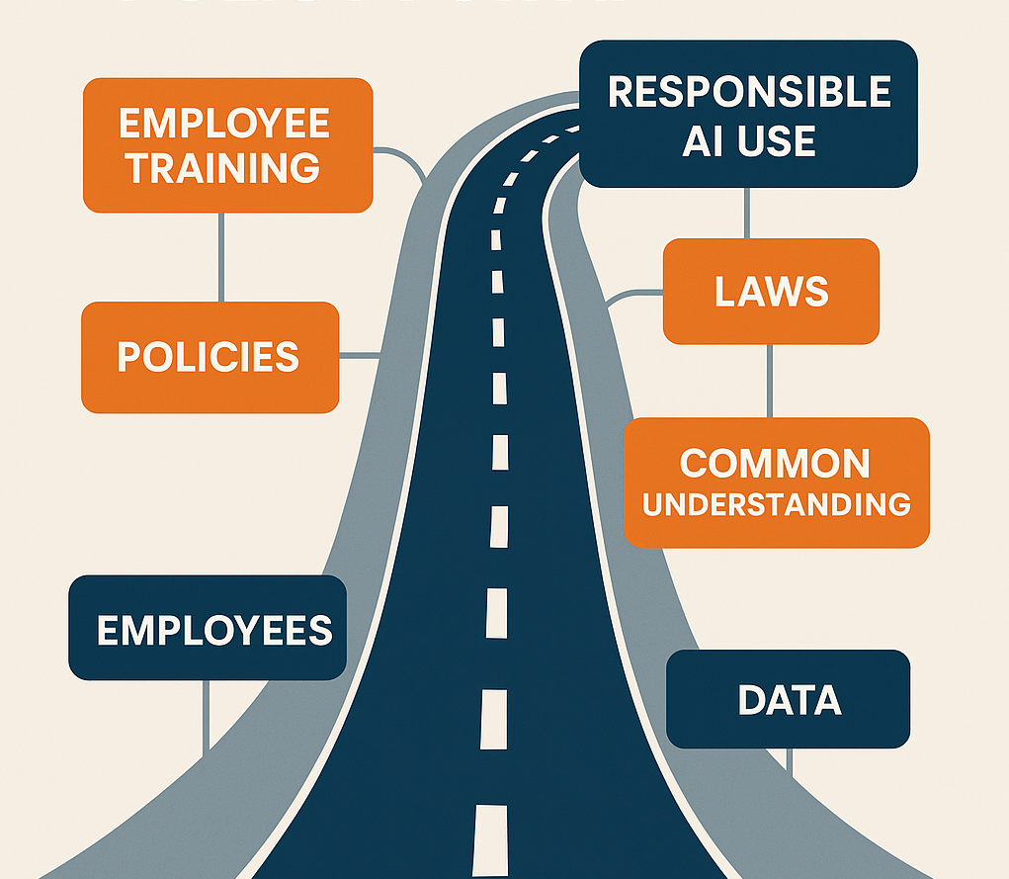
The Guardrails aren’t a single policy but a sytem
Acceptable Use Involves:
Policies
Laws
Wise decision making
Training
Clear rules

Slide 24
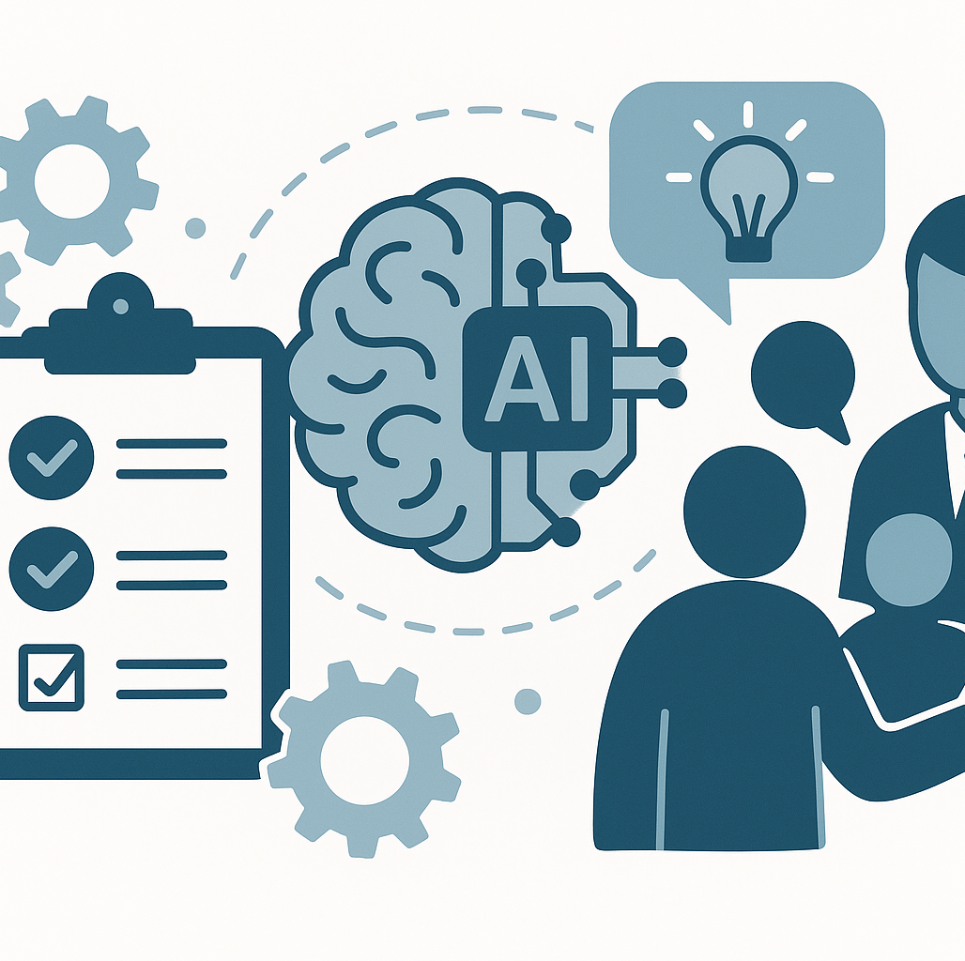
What are the biggest risks for your organization?
Client data
Donor data
Financial data
Copyright/IP
Brand
Accuracy
Bias
Sustainability
Vendors/contractors

Slide 25
Areas of exploration
Appropriate Tools: What system(s) are allowed? Who has access?
Identifying/Mitigating bias: How to we review and evaluate results for bias?
Ensure Accuracy: How do we verify accuracy?
Data Protection and Privacy: How do we align with our existing data privacy policies? What processes are in place?
Transparency/Accountability: When do we disclose use of AI? How to record its use in our work?
Training: What professional development is required?
Misuse (intentional/unintentional): What will we do to prevent misuse? What will happen if we detect misuse?
Reporting Misuse: How is misuse or other policy violation reported?
External Collaborations: What is the process for approving partnerships? Sharing data?
AI Meeting Notetakers: What is our process to assure permission is granted?
Copyright/Intellectual Property: How do we assure our use of AI does not violate intellectual property protections?

Slide 26






Appropriate Tools
Description: Defines clearly which AI tools staff may use and who can access them.
How a Reasonable Policy Might Address This:
Define approved AI tool(s) (e.g., ChatGPT, Grammarly, Canva AI), clearly documented in the organization’s technology policy.
Explore subscription models for data privacy and collaboration
Assign different AI tool permissions based on roles (e.g., development staff can use fundraising analytics AI, marketing staff can use content generation tools).
Regularly update the list based on data security and privacy audits.

Slide 27

Identifying & Mitigating Bias
Description: Establishes methods to actively review AI outputs for potential bias or unintended discrimination.
How a Reasonable Policy Might Address This:
Require human oversight for AI-generated donor segmentation to prevent demographic bias (racial, socioeconomic, geographic).
Conduct quarterly “AI bias audits” to review AI-assisted communication materials (newsletters, appeal letters) for unintended stereotyping or exclusion.
Provide staff training on recognizing AI-generated biases.
Require or review two-person proofreading and other quality control processes

Slide 28

Ensuring Accuracy
Description: Outlines procedures to verify that AI-generated content or data is accurate and trustworthy.
How a Reasonable Policy Might Address This:
Require verification of all AI-generated statistics or factual statements before public dissemination (e.g., fact-check program descriptions in grant proposals, click and read citations).
Implement a two-step review process for AI-produced donor or client reports: one review for accuracy, one for ethical alignment.
Clearly document and archive reviews for accountability.

Slide 29

Data Protection & Privacy
Description: Ensures AI use aligns fully with the nonprofit’s existing data privacy policies.
How a Reasonable Policy Might Address This:
Prohibit or limit staff from uploading sensitive client or donor information (personally identifiable or health-related data) into public AI tools.
Create explicit guidelines for anonymizing data before AI processing (e.g., removing names, locations, specific details that identify individuals); require review/approval of manager before AI processing.
Train staff annually on secure data handling practices related to AI tools.

Slide 30

Transparency & Accountability
Description: Clarifies when to disclose AI usage and how to maintain accountability.
How a Reasonable Policy Might Address This:
Include a requirement for staff to note explicitly when AI significantly contributed to written materials or data analyses presented to boards or funders.
Maintain an internal log of AI tool use for transparency and auditing purposes.
Establish clear internal reporting lines for staff questions or concerns about AI transparency.

Slide 31

Training & Professional Development
Description: Defines the professional development required to responsibly use AI within the nonprofit.
How a Reasonable Policy Might Address This:
Require staff using AI to complete an annual internal training session covering data ethics, AI biases, and privacy risks.
Provide specialized training modules depending on the AI tools staff will use (fundraising tools, marketing automation, program evaluation tools).
Evaluate staff competence periodically through brief assessments or scenario-based exercises.

Slide 32
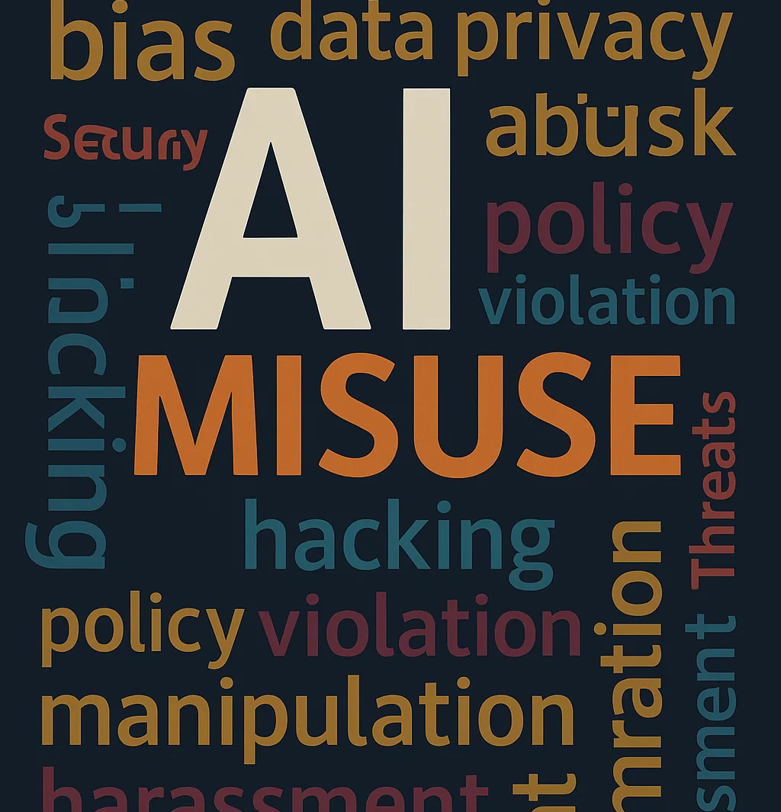
Misuse
Description: Defines misuse clearly and outlines preventive measures and disciplinary actions.
How a Reasonable Policy Might Address This:
Clearly define misuse, such as inappropriate use of sensitive data, plagiarism, or generating misleading content.
Implement clear warnings within tools themselves to prompt cautious data handling (e.g., pop-up reminders when uploading data).
Update existing policies to include AI infractions. Outline graduated responses to misuse: first accidental misuse triggers training, intentional misuse triggers disciplinary review.

Slide 33

Reporting Misuse
Description: Clarifies reporting channels and procedures for suspected misuse of AI tools.
How a Reasonable Policy Might Address This:
Update and leverage existing whistleblower policies for confidential reporting managed by HR or IT.
Train staff annually on how to recognize and report misuse.
Foster a culture emphasizing responsible AI use through ongoing communication and feedback mechanisms.

Slide 34

External Collaborations
Description: Provides guidelines for approving partnerships or vendors who utilize AI.
How a Reasonable Policy Might Address This:
Require external vendors using AI (e.g., fundraising consultants, CRM providers) to submit their AI usage policy or data security standards for review.
Include data-sharing protocols explicitly in contracts with vendors or partners (e.g., requiring vendor compliance with your privacy standards).
Regularly audit these collaborations to ensure ongoing compliance and alignment with organizational values.

Slide 35
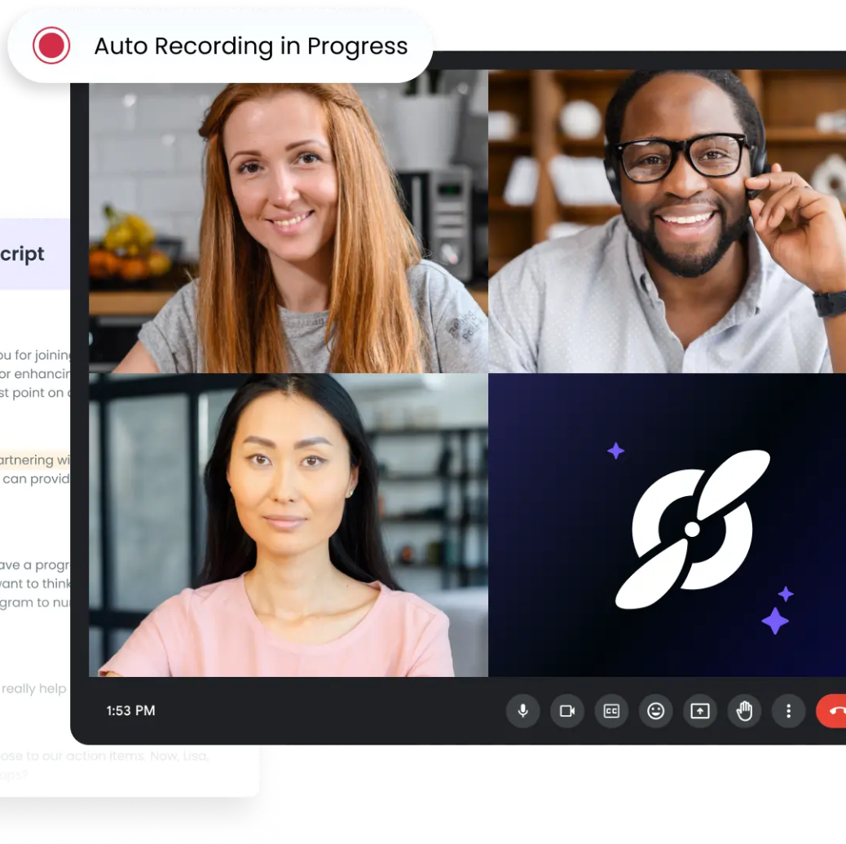
Meeting Notetakers
Description: Outlines consent processes required for AI-generated meeting notes or transcriptions.
How a Reasonable Policy Might Address This:
Require explicit participant consent (written or verbal) before using AI tools (e.g., Otter.ai, Zoom transcription) to record meetings.
Clearly label meetings using AI transcription in calendar invites, so participants can opt-out if necessary.
Develop an internal guideline outlining secure storage, access, and deletion policies for AI-generated meeting transcripts.

Slide 36

Copyright/IP
Description: Ensures compliance with intellectual property laws and best practices in AI-generated content.
How a Reasonable Policy Might Address This:
Require checking licenses and terms of service when using AI-generated images, graphics, or text (e.g., DALL·E, Adobe Firefly).
Maintain subscriptions or licenses to AI tools specifically designed to deliver copyright-safe outputs.
Provide training on basic copyright law, fair use, and public domain concepts for staff who generate or approve AI-generated materials.

Slide 37
Short-term
AI Use Guidelines courtesy of OpenAI
We encourage you to use AI to become more efficient and effective.
Do not share any personally identifiable information about clients/donors/students/etc. in an AI tool. Ask for clarity if there is any doubt.
All of our existing data privacy and security requirements apply here.
You are responsible for the quality and accuracy of AI generated work products.
Disclose when you use AI to support your work. This helps the organization to learn and grow. AI is not cheating.
Even when your AI supported work is safe and accurate, some clients/partners may be concerned or opposed. Use judgement/ask your supervisor to consider disclosing or avoiding AI use in such cases.
Short-term
AI Use Guidelines
courtesy of OpenAI

Slide 38
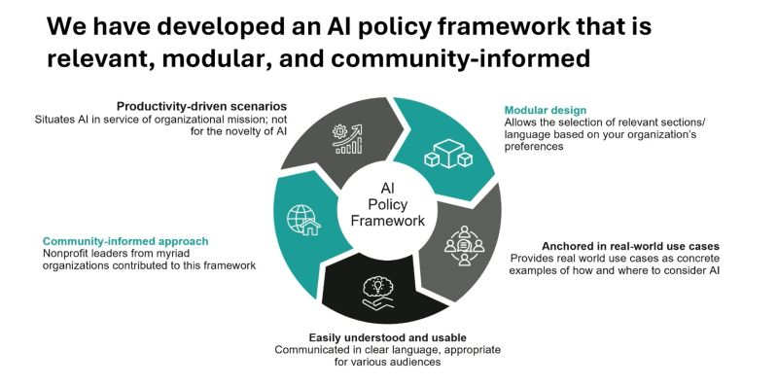
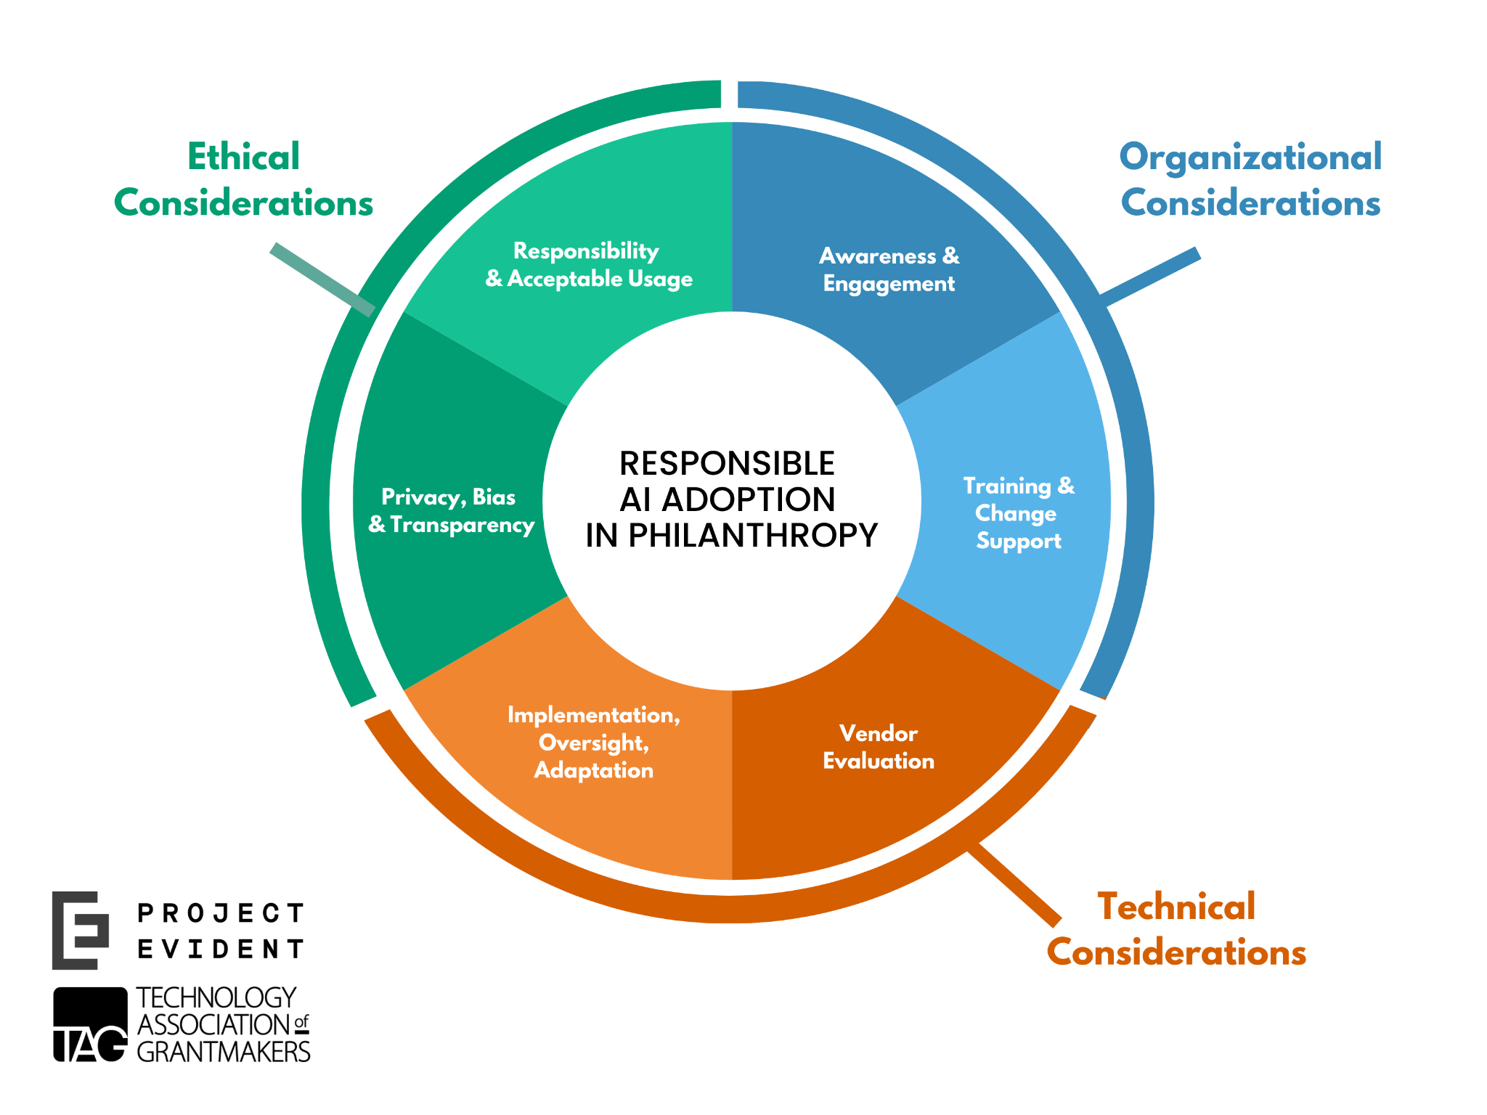
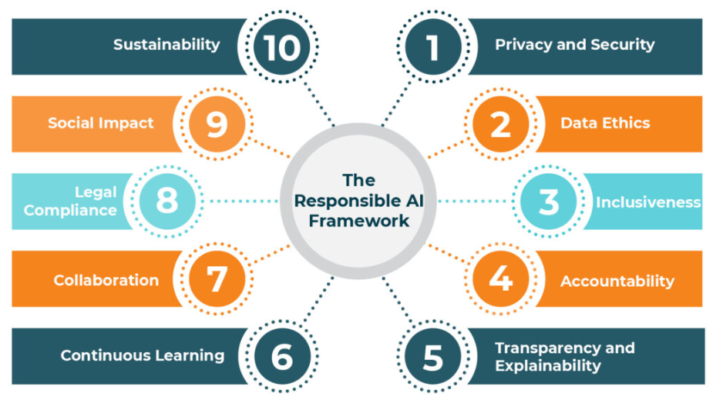
1. Choose a Framework
Just Choose One

Slide 39

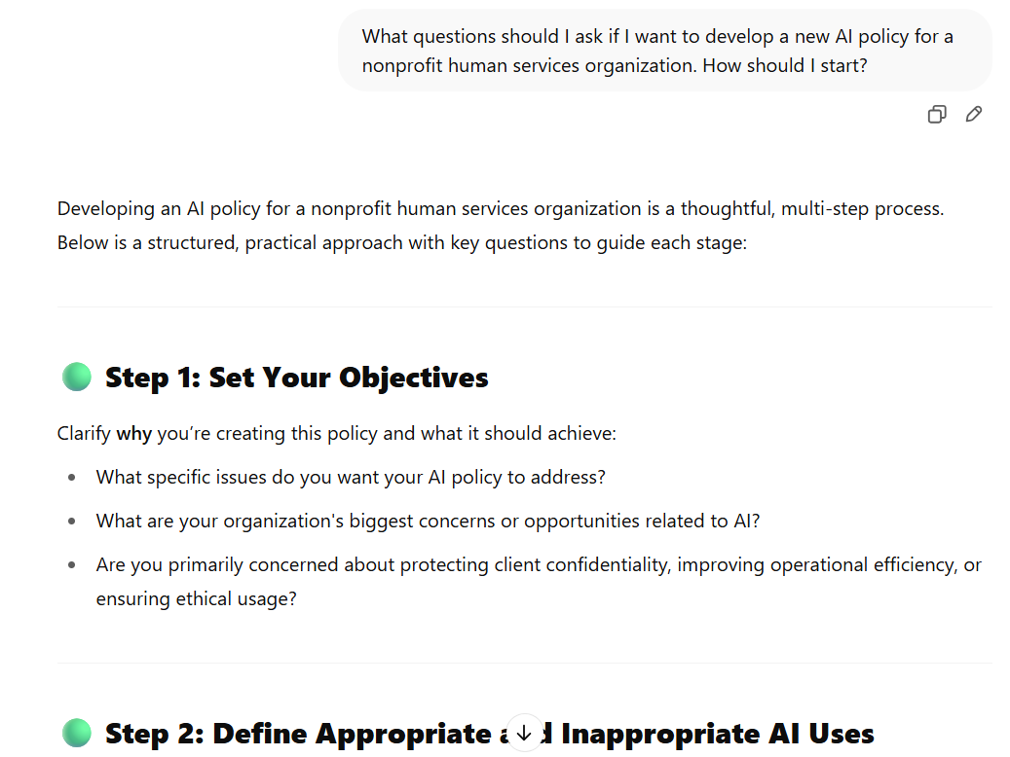
2. Start the Conversation

Slide 40
3. Policy Development
Existing Policies to Review: | Potential New AI Policies?
Data privacy & confidentiality | Data ethics and anonymization
Information security | Acceptable use
Technology use | Meeting/transcription consent
HR and whistleblower | Misuse reporting and response
Equity, diversity & inclusion | Bias/accuracy review
Communications/Social Media
Vendor/Third party agreements
IP/Copyright
Review/update existing policies
(low hanging fruit)
Create new AI-specific policies where needed
Don’t reinvent the wheel!

Slide 41
4. Launch Training/Professional Development
FREE:
Align to professional learning plan
Lunch and learn open conversation
Youtube
Nonprofit.courses
Commercial webinars
Newsletters
NOT FREE:
Consultant(s)
Certifications
Paid courses
Formal coursework

Slide 42

You CAN do it!
What’s your biggest risk right now?
Identify a framework (optional, but helpful)
Start the conversation
Develop/Update policies
  Review/update existing policies
  (low hanging fruit)
  Create new AI-specific policies where needed
Launch training and support
  Start small: lunch and learn with one another

Slide 43

You have Support!
Other Useful Resources:
Your team
AI itself
Your board
Your IT folks
Your colleagues
Consultants

Slide 44
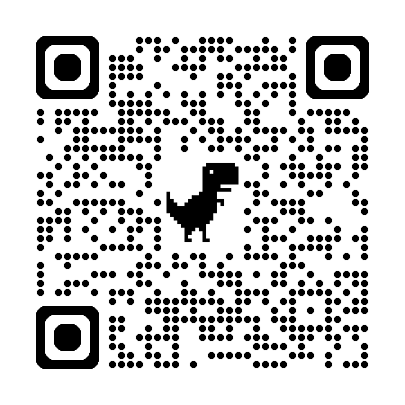
Feedback is a gift!
How’d we do?
https://forms.gle/fQjon9FzYE38z3ym8

Slide 45
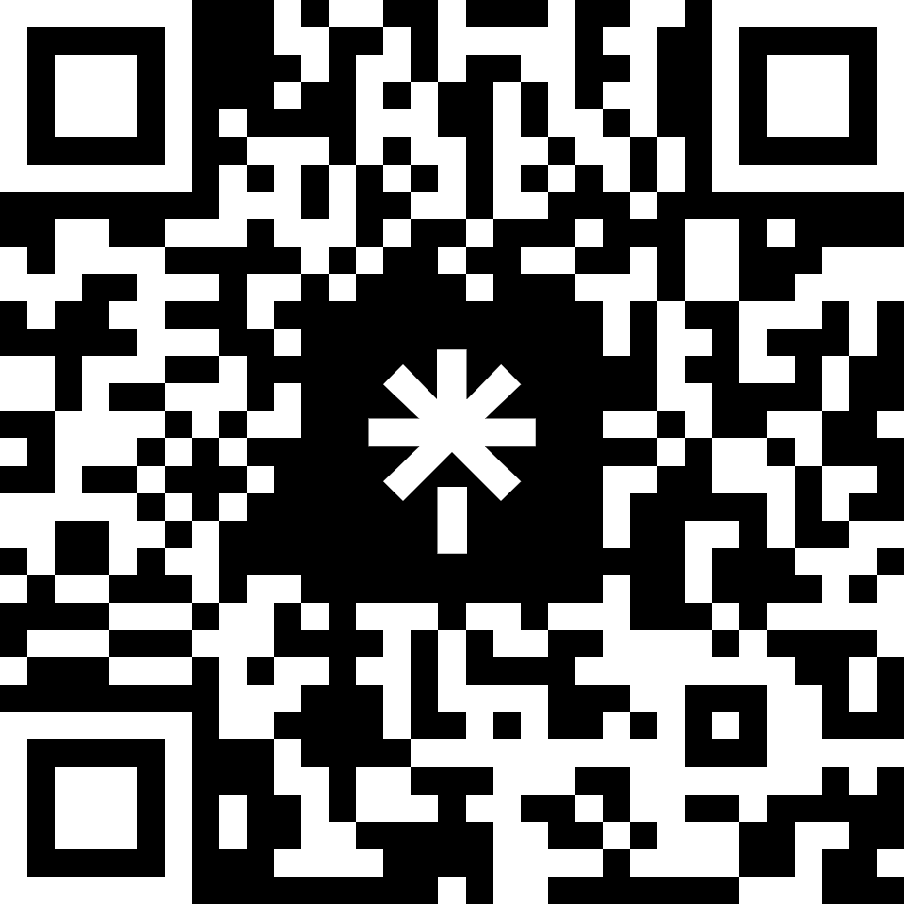
Resources
https://linktr.ee/bonpartners

