Slide 1
Clear, Calm, Credible: Communication Strategies for Difficult Moments
Facilitated by: Jenora Ledbetter
The Self Care Network LLC

Slide 2
Why Communication Matters in Crisis
What you say — and how you say it — shapes trust
Clarity prevents confusion
Calm prevents escalation
Credibility sustains confidence

Slide 3

The “Purple Elephant” In The Room
What’s not being said is often what’s most shaping the room

Slide 4
The 3 C’s Framework
CLEAR – Simplify what you say
CALM – Control your energy
CREDIBLE – Align words + values

Slide 5
Why People Panic: The Trust Gap
In chaos, people want certainty
Silence breeds stories
Emotion fills the space data leaves

Slide 6
Common Crisis Pitfalls
Over-communicating too soon
Withholding too much information
Reactive tone (“We didn’t do anything wrong!”)
Inconsistent messages across leaders

Slide 7
Step 1: Identify Your Audience
Ask:
Who needs reassurance?
Who controls the narrative?
Who could misunderstand silence?

Slide 8
Step 2: Prioritize Your Message
🎯 What Must Be Said Right Now: Non-negotiable facts, safety info, next steps
⏳ Can Wait Until Verified: Investigation details, long-term fixes
🚫 Never Disclosed: Speculation, blame, confidential info

Slide 9
How Fear Shapes Messaging
“In today’s hostile political climate, marginalized communities are under constant attack. Without urgent support, our programs may be forced to shut down, and the voices of those we serve will be silenced.”
“We believe every person deserves dignity, opportunity, and a voice. That’s why we partner with communities to build inclusive programs that uplift, protect, and empower, no matter the political landscape.”
Which mission statement feels stronger?
What words or phrases in each version made you feel connected/ or disconnected?
Do you recognize any-fear based language in your own mission or messaging?

Slide 10
Step 3: Stay Aligned Under Pressure
One consistent voice
Verify before amplifying
Empathy ≠ admission of guilt
Calm is contagious

Slide 11
Reflection Activity: Pressure Check
Reflect & Share:
“When I feel cornered, my default communication style is…”
Overexplaining
Shutting down
Getting defensive
Trying to fix everything

Slide 12

Group Exercise: Crisis Scenario
Your organization faces a sudden reputational threat.
In groups:
Identify key audiences
Decide what to say, what to hold
Draft your first message headline

Slide 13

Scenario Card 1: Funder Backlash
A major funder questions your commitment to DEIB, claiming it’s “too political” and threatens to pull funding unless you adjust your messaging.
What’s your gut reaction to this message? What emotions come up as a leader, communicator, or team member?
What’s your first communication priority: preserving the relationship, protecting the mission, or managing public perception? Why?
What would a clear, calm, credible first response look like?
How do you manage internal morale if staff feel this funder’s stance conflicts with your DEIB commitment?

Slide 14

Scenario Card 2: Community Criticism
A local leader calls out your organization for “not serving the whole community” and accuses you of exclusion. The comments are going viral on social media.
What’s your first instinct—to defend, explain, or stay silent? What does that reveal about your leadership style?
Who internally should speak first—and who definitely should not?
What would a Clear, Calm, Credible first statement look like (one sentence max)?
Beyond a public response, what internal actions or listening spaces could rebuild community confidence?

Slide 15

Scenario Card 3: Staff Walkout
Staff members resign publicly, citing your organization’s lack of action on racial equity. Their resignation letter is shared online.
What’s your first reaction when you see the resignation letter online — fear, defensiveness, empathy, confusion?
How can you acknowledge the resignations without dismissing or validating every claim?
How do you care for remaining employees, so they don’t feel silenced or blamed?

Slide 16

Scenario Card 4: Program Ban
New state legislation restricts how nonprofits can discuss equity and inclusion in schools. One of your major programs is directly affected.
Who are your key audiences (staff, schools, parents, board, media, community partners)? Which one must hear from you first?
Draft one clear, calm, credible message that: Respects the law, Protects your staff and organization, Reinforces your long-term values.
What long-term communication strategies can protect your mission and credibility when operating in politically restricted environments?

Slide 17

Scenario Card 5: Media Hit Piece
A news outlet publishes a critical piece that misrepresents your mission and programs. You’re getting calls from stakeholders demanding a response.
What emotions are likely surfacing for your staff and board—anger, embarrassment, fear?
What would a clear, calm, credible message sound like in this moment? (Write 1–2 sentences.)
What systems or protocols (e.g., media briefings, staff talking points) could help prevent a repeat situation?

Slide 18
Key Takeaways
Crisis doesn’t create leaders—it reveals them.
Remember:
Clarity builds trust.
Calm builds confidence.
Credibility builds long-term reputation.

Slide 19
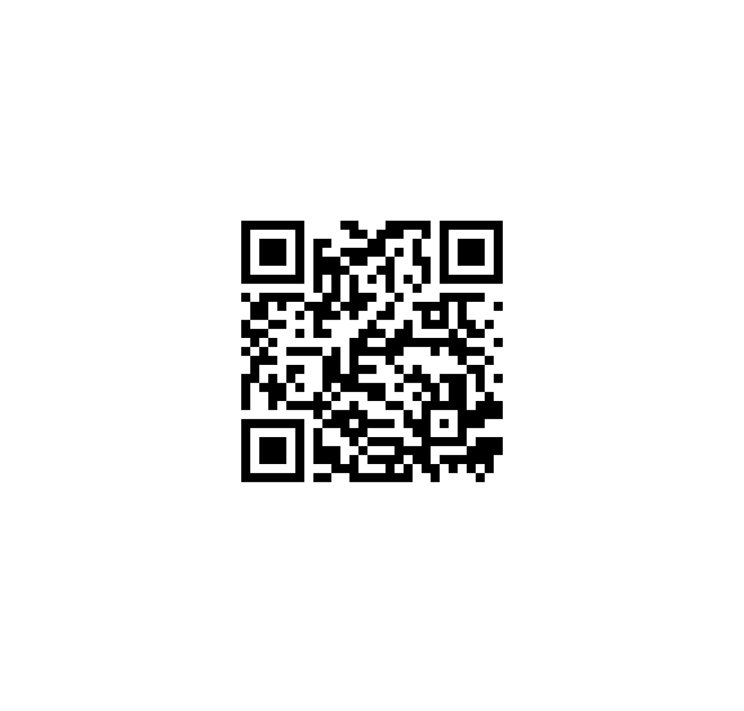
Ready to strengthen your communication leadership?
Book a 1:1 Coaching Session with Jenora Ledbetter. If you book today, you get
50% off your first session
A complimentary review of one organizational communication document (Email, statement, or policy — I’ll personally refine it for clarity, tone, and credibility.)
(Offer valid for participants who book within 24 hours of this workshop)
You’ll walk away with:
✅ A personalized “Clear, Calm, Credible” communication plan
✅ A message framework tailored to your organization’s tone
✅ One-on-one rehearsal and feedback for real-world situations

