Slide 1


No Title?
No Problem.
Lead Anyway.
Claim Your Leadership
Notes:
Good morning - my name is Coach Jackie.
Introduce self
We are about to press some new leadership buttons today - but no title required.
As a leadership coach and HR professional, I’ve worked with so many talented, capable people who are quietly leading every day — even if they don’t see it that way.
I see professionals with incredible ideas holding back because they don’t have a title. I see emerging leaders playing small to avoid stepping on toes, or waiting for someone else to give them permission to lead.
In coaching conversations and in HR roles, I’ve watched what happens when those same people finally give themselves that permission — when they speak up, take initiative, and lead from who they are, not where they sit. It changes everything. Their confidence shifts. Their teams respond differently. Influence starts to flow both ways.
That’s why this work matters to me. Because leadership isn’t a job description — it’s a mindset and a practice. And I’ve seen firsthand how frameworks like PACT and the 3 R’s can unlock what’s already inside people: Presence, Awareness, Courage, and Trust — along with the ability to influence through Respect, Relevance, and Relationships.
This session is my way of helping people stop waiting for titles and start leading anyway.

Slide 2

Share a story of why being here is important.
Self? Team? Organization? Global Community?
    Share 2-3 minutes
    Notice/Acknowledge 30 seconds
    Rotate

Slide 3

Redefining Leadership
    Leadership Title
    Inner work: PACT Framework
    Outer Stategy: 3 R’s of Influence
    Influence happens at the intersection of who you are and how you connect.
“Leadership is shifting from hierarchy to humanity.”
Notes:
“First, I just want to say — hearing why you all showed up today was powerful.
What I noticed in your reflections was this common thread: we’re all here because we want to matter. We want to make an impact. We want to use our voice, even when it’s uncomfortable, and to show up as the kind of leader who lifts others, not waits for the title to do it for us.
That’s exactly what today is about — bridging the gap between what you feel called to do and how you show up and influence every day. So let’s take that energy you just shared and build on it.”
(Pause, smile, and click to next slide.)
Slide 5 Script — From Inner Work to Outer Impact
“When we talk about leadership without a title, there are really two sides to it — the inner work and the outer strategy.
The inner work is about who you are — how you manage your mindset, your energy, and your reactions. That’s where the PACT Framework comes in — Presence, Awareness, Courage, and Trust. These are the habits and mindsets that help you lead from within.
But inner strength alone isn’t enough. We also need a way to connect that energy outward — to communicate it, to make it land with others, to turn it into action that gets noticed. That’s where the 3 R’s of Influence come in — Respect, Relevance, and Relationships.
When you bring these two frameworks together, you create this intersection — a space where you don’t need authority to create impact. You simply need alignment between who you are and how you connect.
So as we move forward, we’ll start with PACT — the inner foundation of leadership. Then we’ll move into the 3 R’s — the outer practice of influence. Together, they form your playbook for leading anyway.”
As we go through this next section, I invite you to think about which side you naturally lean toward — are you stronger in the inner work or the outer strategy? No judgment either way — this is all about building your full leadership toolkit.”

Slide 4
  P = Presence: Show up fully, grounded in purpose.
  A = Awareness: Read yourself. others, the system.
  C = Courage: Speak and act even when uncomfortable.
  T = Trust: Build it, extend it and trust yourself.
Introducing PACT
Notes:
“So we just talked about how leadership without a title starts on the inside — that who you are being shapes how you’re influencing.
Now, let’s take a closer look at what that inner work actually looks like in action. Because if you want to lead others, it starts with how you lead yourself.
I call this framework PACT — it’s both a promise to yourself and a practice you can live into every day.”
(Pause here. Change slide.)
🟡 Slide 6 — Introducing PACT
“The PACT Framework is made up of four essential elements of inner leadership: Presence, Awareness, Courage, and Trust.
These four qualities are what I see in every effective leader — whether they have a title or not. They are also the same qualities that make us magnetic. They build influence from the inside out.”
(Point to each one as you go — use hand gestures or brief pauses for emphasis.)
Presence
“Presence is about how you show up. It’s your energy, your attention, your ability to be fully here — not multitasking, not reacting, but grounded and intentional.
It’s what people feel before you even speak.”
Awareness
“Awareness is how you see yourself and your environment.
It’s noticing what’s going on inside you — your emotions, assumptions, biases — and also tuning into what’s happening around you. It’s reading the room, the system, the culture. Great leaders can do both.”
Courage
“Courage is how you take action when it would be easier not to.
It’s speaking up when something feels off. It’s advocating for someone else. It’s choosing integrity over comfort.
Courage doesn’t mean you’re not afraid — it means you move anyway.”
Trust
“And Trust is the glue that holds it all together.
Trust in yourself — in your intuition and your capacity to handle what comes.
Trust in others — giving them the benefit of the doubt, setting clear expectations, and following through.
When people can trust you — and when you can trust yourself — your leadership expands.”
Closing + Transition to Next Slide
“These four — Presence, Awareness, Courage, and Trust — are the foundation of your leadership.
In the next few slides, we’re going to break them down one by one and explore how they show up in your daily work and relationships.
And as we do, I invite you to reflect: Which one of these do you naturally lead with? And which one might be asking for a little more attention right now?”

Slide 5
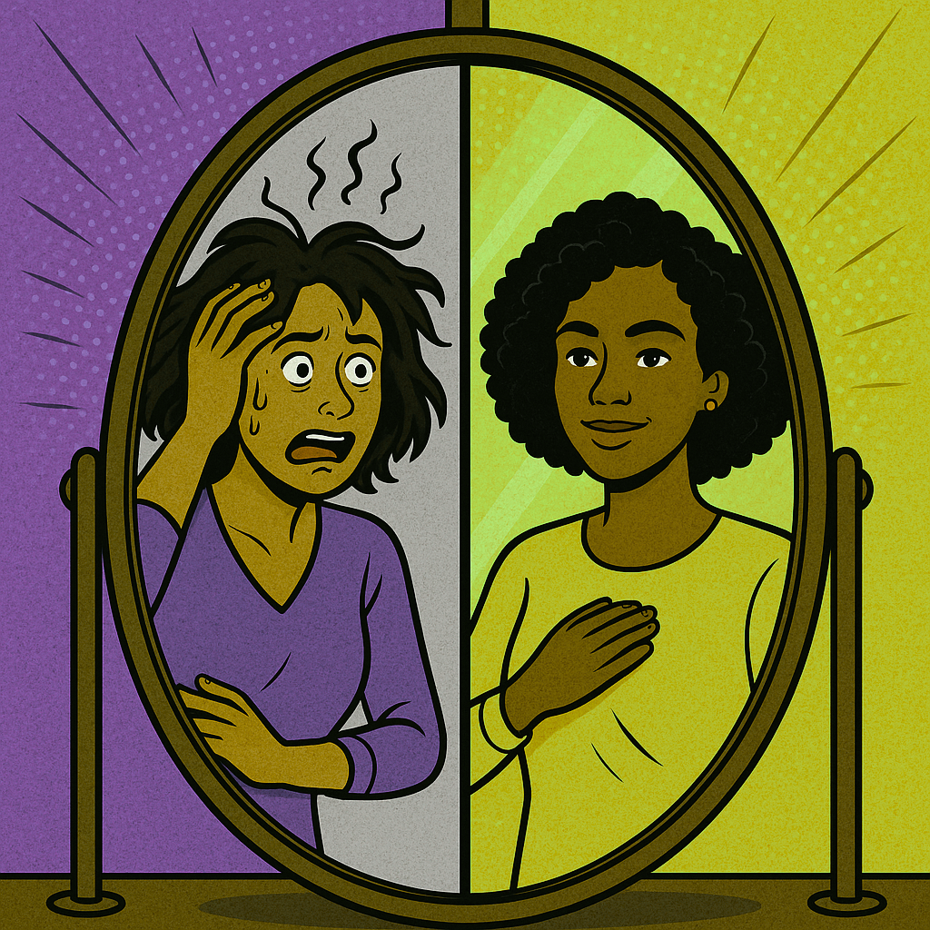
PRESENCE
How Do Others Feel When You Walk In A Room?
Notes:
So now that we’ve walked through all four parts of the PACT Framework, let’s go deeper into the first one — because it’s where all leadership begins.
We’re starting with Presence. It’s your foundation. It’s what people feel before you ever say a word.”
“When I talk about Presence, I’m talking about how you show up — physically, emotionally, and energetically.
Presence isn’t about being the loudest voice in the room; it’s about being the most centered one. It’s that grounded confidence that says, ‘I belong here.’
In my coaching and HR work, I’ve seen leaders who walk into a room and immediately shift the energy — not because of a title, but because of their presence. They’re calm, grounded, and intentional. You can feel that they’re listening, not waiting to talk. That’s influence.
Here’s the truth: your energy leads before your words ever do.
People don’t just remember what you say — they remember how they felt around you.”

Slide 6

AWARENESS
What dynamics do you sense but rarely name?
Notes:
“Now that we’ve grounded ourselves in Presence — how we show up — let’s talk about what we notice when we do.
Presence is about being centered.
Awareness is about being conscious — of yourself, of others, and of the environment around you.
It’s what turns good intentions into wise decisions.”
(Pause, then move to slide.)
💬 Facilitator Script
“When we talk about Awareness, we’re talking about seeing clearly — both inward and outward.
Inward awareness is self-awareness — understanding your own triggers, habits, and emotional patterns. It’s noticing when your energy shifts, when your inner critic shows up, or when you start reacting instead of responding.
Outward awareness is reading the room, tuning into others, and understanding the dynamics that may not be spoken out loud. It’s paying attention to body language, tone, and timing — all the subtle cues that tell you how your message is landing.”
(Pause to let that settle.)
“The best leaders I’ve coached — whether or not they had a title — all share this ability to see what others miss. They listen between the lines. They sense tension early. They notice when morale dips or when a team member needs encouragement.
That kind of awareness doesn’t just make you observant; it makes you relevant. You become the person who understands what’s really happening — not just what’s being said.”

Slide 7

COURAGE
Where are you holding back your leadership voice?
Notes:
“So we’ve explored Awareness — the power of noticing, of tuning in to what’s happening within you and around you.
But awareness alone isn’t enough. Because once you see something clearly, the next question becomes…
What will you do about it?
And that brings us to the next part of PACT — Courage.”
(Pause briefly to let that land, then move to the slide.)
💬 Facilitator Script
“Courage is one of my favorite topics — because it’s often misunderstood.
When people hear the word courage, they picture something big and bold — like standing on a stage or calling out injustice. But most courage in leadership looks much smaller — and quieter.
It’s having a hard conversation when it would be easier to avoid it.
It’s admitting a mistake instead of defending it.
It’s raising your hand when you’re not 100% sure you’re ready.
Courage is doing the right thing, not the comfortable thing.”
“And here’s the truth — courage doesn’t mean you’re not afraid. It means you move anyway.
Fear is part of growth. If you wait to act until the fear is gone, you’ll never do the thing that truly matters. Courage means you act with fear, not without it.”
🧠 Coach Jackie Insight
“In my HR and coaching work, I see this all the time — talented professionals holding back their voice because they don’t want to ‘rock the boat.’
But here’s what I’ve learned: if you speak with respect, if you align your message with what’s relevant, and if you’ve built relationships — your voice will land.
And that’s where the 3 R’s of Influence show up in action.
Courage isn’t loud; it’s relational. It earns respect, strengthens trust, and deepens connection.”
✍️ Reflective Prompt / Activity
“Take a moment to think about this question — Where are you holding back your leadership voice?
Maybe it’s in a team meeting where you tend to stay quiet.
Maybe it’s in a conversation with your manager, where you have ideas but fear being misunderstood.
Or maybe it’s in advocating for yourself — for the promotion, the project, or the pay you deserve.
Jot it down. Don’t overthink it. Just one area where your courage wants to stretch.”

Slide 8

TRUST
Career Currency
Notes:
🟢 Slide 10 — TRUST
Slide Content:
Trust is the foundation for strong Relationships.
The currency of influence.
Activity: Trust accelerators vs. trust killers.
🎤 Transition from Slide 9 → Slide 10
“So we just talked about Courage — the ability to act, speak up, and lead even when it’s uncomfortable.
But courage without trust? That’s risky business.
Because when people don’t trust your intentions, even the most courageous act can be misinterpreted.
Which brings us to the final — and perhaps most important — element of the PACT framework: Trust.”
(Pause for a breath and switch to the next slide.)
💬 Facilitator Script
“Trust is the currency of leadership. It’s the invisible thread that holds teams, relationships, and organizations together.
Without trust, influence doesn’t stick — it slides right off.
With trust, your ideas carry weight, your voice resonates, and your presence creates psychological safety.”
(Pause for a moment — let that land.)
“In my HR and coaching work, I’ve seen how everything changes when trust is high. People communicate more openly. They collaborate more easily. They take ownership.
But when trust breaks down — even a little — we see second-guessing, defensiveness, and distance. And here’s the truth: once trust is broken, it takes intentional action to rebuild it.”
🧭 Coach Jackie Insight
“We build trust not through big, dramatic moments — but through small, consistent behaviors.
It’s the follow-up email you actually send.
The boundary you honor.
The confidentiality you keep.
Trust grows when our actions match our words. And that’s where influence becomes authentic — not forced.”
⚖️ Facilitated Mini-Activity: Trust Accelerators vs. Trust Killers
“Let’s do a quick brainstorm together.
What are the Trust Accelerators in your workplace — the behaviors that build confidence, connection, and credibility?
And what are the Trust Killers — those subtle actions or habits that quietly erode it?”
(If virtual: invite them to type responses in chat. If in person: use a flip chart or shout-outs.)
Capture responses and affirm patterns:
Accelerators: consistency, transparency, follow-through, active listening.
Killers: gossip, avoidance, inconsistency, lack of accountability.
“This is where awareness meets action. Presence, Awareness, and Courage are powerful — but Trust makes it sustainable. It’s the foundation of influence and the heartbeat of leadership.”
💬 Closing + Transition to Next Section (From Inner to Outer Influence)
“So now you’ve met all four parts of PACT — Presence, Awareness, Courage, and Trust.
These are the inner muscles of leadership — the practices that help you lead yourself before you lead others.
Next, we’ll explore how to take this inner clarity and bring it outward — through the 3 R’s of Influence: Respect, Relevance, and Relationships.
That’s where your leadership starts to ripple out and shape your culture, one conversation at a time.”

Slide 9
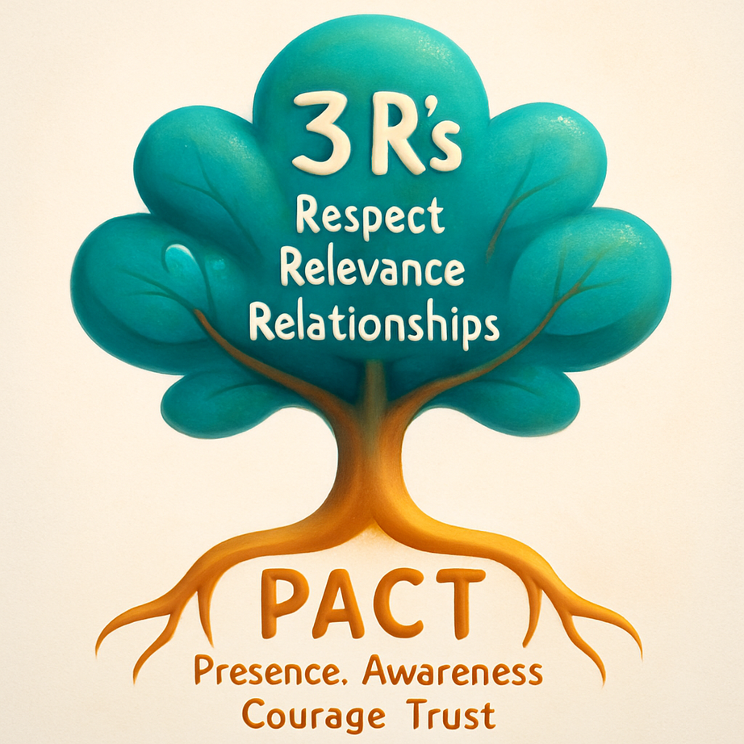
Inner Leadership to Outer Influence

Slide 10
The 3 R’s of Influence
    Respect
    Relevance and
    Relationships
Notes:
“So we’ve just explored how PACT — Presence, Awareness, Courage, and Trust — fuels your leadership from the inside out.
You’ve built that inner foundation. Now, let’s shift from being to influencing.
Because leading without a title isn’t just about who you are — it’s about how you connect.
And that’s where the 3 R’s of Influence come in — they’re your outer strategy, the way you turn your presence into impact.”
(Pause, smile, then move to Slide 12.)
💬 Slide 12 — The 3 R’s of Influence
Slide Content:
Respect — Earn credibility through presence, reliability, and honoring others’ perspectives.
Relevance — Align your ideas with what matters most.
Relationships — Build authentic trust before you need it.
🎤 Facilitator Script
“Let’s talk about what really moves people — because influence isn’t about titles, authority, or hierarchy. It’s about connection.
The 3 R’s of Influence — Respect, Relevance, and Relationships — are how you turn your leadership energy outward in a way that inspires others to listen, engage, and collaborate.”
💛 1. Respect – The Foundation of Influence
“Respect is earned through consistency and presence — not control.
It’s how you show up, how you listen, and how you treat people even when they disagree with you.
In leadership coaching, I often say: Respect isn’t about being liked. It’s about being trusted.
You earn Respect when people know they can rely on your word, your follow-through, and your integrity — even when things get hard.”
(Optional prompt)
“Who’s someone you respect deeply — and what do they do that earns that respect?”
💬 2. Relevance – The Connector of Influence
“Relevance is the key to being heard.
You might have the best idea in the world, but if it’s not connected to what matters most to your audience — it won’t land.
When you speak the language of what’s relevant, you show you understand the bigger picture. You’re not just adding noise; you’re adding value.”
(Practical tip)
“In meetings, frame your ideas in context: ‘Here’s how this helps our team reach its goal,’ or ‘This aligns with our mission to improve X.’
That small shift makes your message stick.”
💙 3. Relationships – The Heart of Influence
“And finally — Relationships.
Influence flows through relationships.
The stronger your connections, the more willing people are to listen, collaborate, and support your ideas.
This doesn’t mean you have to be everyone’s best friend — but it does mean investing in authentic relationships built on trust, curiosity, and empathy.”
(Coach Jackie insight)
“In HR and coaching, I’ve seen leaders transform entire teams — not by being the loudest, but by being the most relational.
They take time to understand others, build trust, and create safe spaces where people feel seen.
That’s real leadership.”
🌟 Closing Reflection / Transition to Next Slide (Slide 13 – Quick Application)
“So if PACT is how you lead yourself, the 3 R’s are how you lead others.
Respect earns credibility.
Relevance ensures your message matters.
Relationships make influence sustainable.
And when you bring those together — you lead anyway.
Next, let’s take a few minutes to apply this to your world — to map your influence strategy and identify where one of these R’s could help you move the needle.”

Slide 11


Think about a real situation — it could be a current challenge or a past experience — where you wanted to have more influence or impact.
1️⃣ What was happening in that situation?
2️⃣ Who were the key people involved?
3️⃣ Which of the 3 R’s — Respect, Relevance, or Relationships — do you think was most critical in that moment?
4️⃣ What’s one small action you can take now to strengthen that R — and increase your influence going forward?
    Share 2-3 minutes
    Notice/Acknowledge 30 seconds
    Rotate

Slide 12

Notes:
You might not run the building — but you can absolutely influence how people move through it.”
🧭 Coach Jackie Insight
“In every workplace I’ve been part of — from nonprofits to corporate to coaching clients — influence doesn’t belong to the loudest or the highest title.
Influence belongs to the person who combines clarity, courage, and connection.
When you lead from Presence and apply the 3 R’s — Respect, Relevance, and Relationships — you become that person others turn to. You create change from wherever you stand.”
💬 Optional Group Reflection
“Think about a situation where you’ve felt stuck — where it seemed like decisions were happening above you or around you.
What would it look like to press a different button?
Maybe that’s asking a new question.
Maybe it’s approaching the same person in a new way.
Maybe it’s showing up with more trust and less defensiveness.”
(Pause and let the question breathe. Invite one or two quick shares.)
🌟 Closing + Transition to Slide 15 (Your PACT + 3 R’s Commitment)
“So as we move to our final slide, I want you to remember:
You don’t need a title to make an impact — you just need intention.
You’ve built your foundation with PACT, and now you have the outer tools — the 3 R’s — to amplify your influence.
Next, we’ll wrap up by making it real — you’ll choose one PACT quality and one R you’ll commit to practicing right away.”

Slide 13
Learn, Action & Acknowledge

Slide 14
Thank you for attending!
Reach out to Coach Jackie:
Jackie@CoachJackieRoss.com

